Slide 1
The Importance of Pitch Counts in the MLB
Vivek Divakarla, Suhaib Iqbal

Slide 2
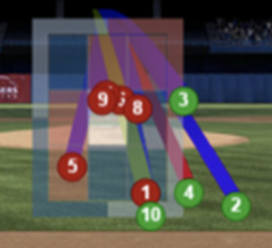
Introduction
Our project is revolved around pitch counts. A pitch count is the number of balls and strikes a batter is currently facing when he puts the ball in play. A 3-1 count would be considered a favorable count while 1-2 would not, as the batter would be closer to getting struck out. We wanted to find out if player performance changed based on the pitch count. Are the best players the best on all counts, or do they only separate themselves from the league on the more favorable counts?
3 Balls – 1 Strike
1 Ball – 2 Strikes
Notes:
Our project revolves around pitch counts in the MLB.
For those of you who don’t know, a pitch count is

Slide 3
Quick Baseball Stats Rundown
BA = Batting Average
Rate at which a batter records a hit.
Not the best metric, but is the most widely known and best shorthand measure
.244 was league average, .300 is considered very good
OBP = On Base Percentage
Rate at which a batter gets on Base. Batting average but includes Walks and Hit By Pitch
League average of .317, .375 considered very good
SLG = Slugging Percentage
Weighted batting average metric that rewards more for Extra Base Hits
1.00 for a Single, 2.00 for Double, 3.00 for a Triple, 4.00 for Home Run
.411 was league average, .500 is considered very good
OPS = OBP + SLG
On Base % + Slugging Percentage
Best of these metrics to analyze a player, combines their ability to get on base with their power. League average of .728, .900 considered very good

Slide 4

Data Collection
We used baseball reference to gather all the data we needed for this project. When looking at a players page, you are able to see their performance on different pitch counts under the batting splits page. We took this data for every player who had over 300 plate appearances in the 2021 season, and made it into our own dataframe, which we conducted this analysis from. The data includes regular baseball counting stats (Hits, Runs, Home Runs), as well as a few other metrics (OPS, Slugging, tOPS+). We chose to focus our study on Batting Average and OPS, as they are two of the most well known metrics and have shown to judge player performance fairly well.

Slide 5
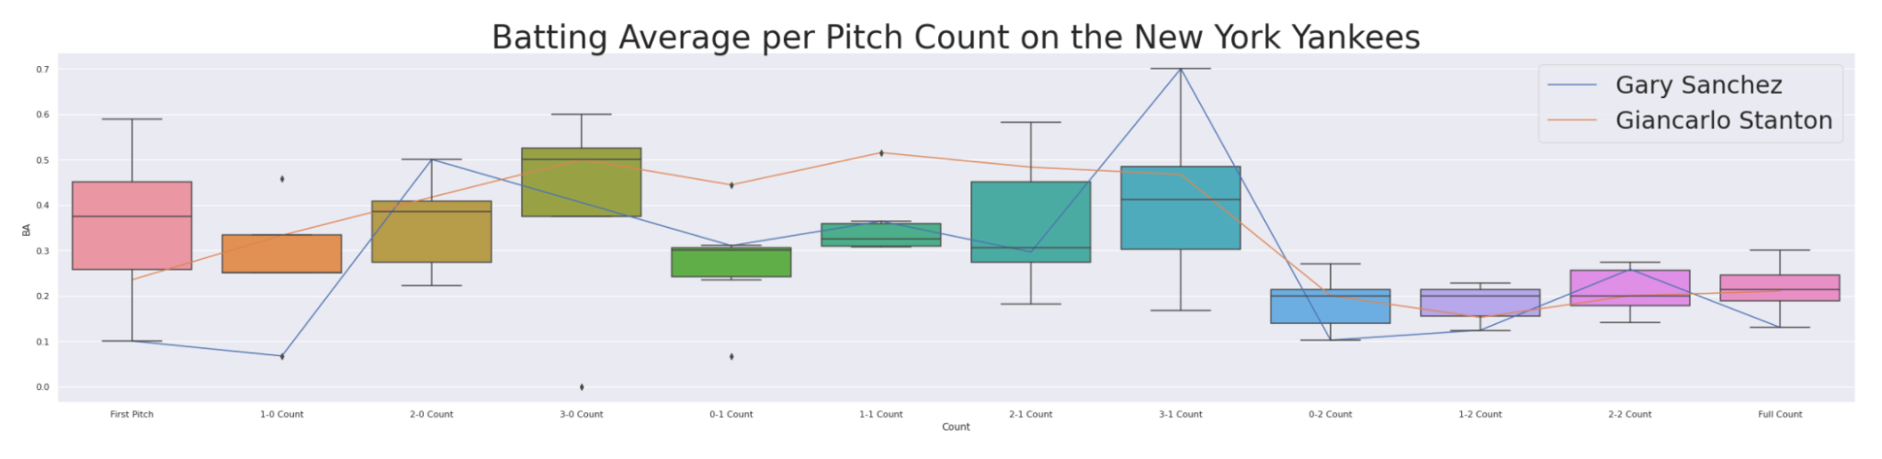
Differences Between Players on a Certain Team
Data Set: Dataframe of Qualified New York Yankees
Notes:
We have sorted the data set to then Yankees who are eligible, comparing them to see their different success rates on each pitch count. As we can see, they all take a dip on 2 strike counts, but perform well on 2-0 and 3-0. Looking at the individual players, Stanton is consistently above average until the 2 strike counts, but Sanchez is a bit of a wildcard, as he is the best in some categories but the worst in others, including a .100 average at first pitch

Slide 6
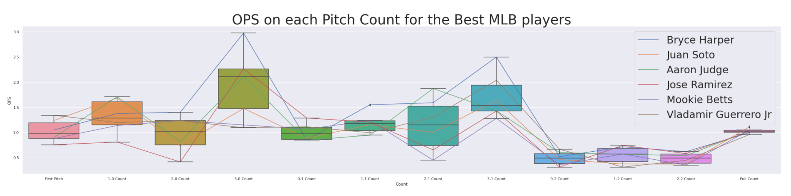
Differences between the Best Players on a Certain Count
Data Set: Dataframe of 6 of the Best Players in the MLB
Notes:
This graph shows 6 of the best MLB players, and how they perform on each count. The league average OPS is .740, a mark these players clear on every count except 0-2, 1-2 and 2-2. They make the most of their opportunities on the early count and on even counts, but like the rest of the league, they are human and struggle on 2 strike counts.

Slide 7
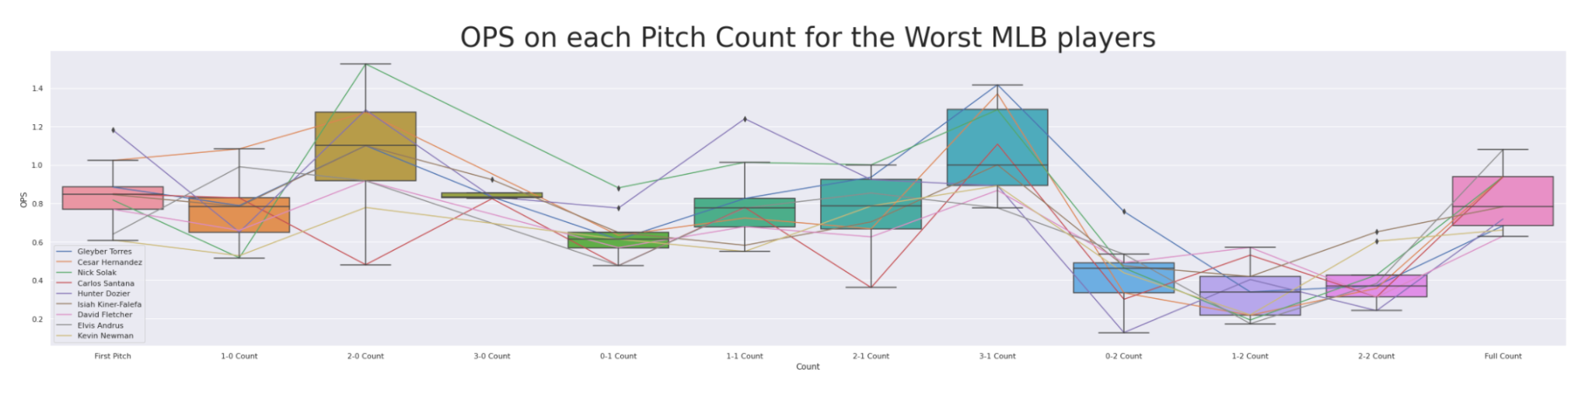
Differences between the Worst Players on a Certain Count
Data Set: Dataframe of 10 of the Worst Players in the MLB
Notes:
This graph shows 10 of the worst players in the MLB, and graphs their OPS for each count. The best hitters graph went up to 3 OPS while this graph only goes to 1.4, clearly showing the lack of top end potential any of these players have. Not only that, but they are even worse when it comes to 2 strike counts. However, one similarity that can be made is the trend going through each count. For both sets of players, 2-0, 3-0 and 3-1 had the highest OPS.

Slide 8
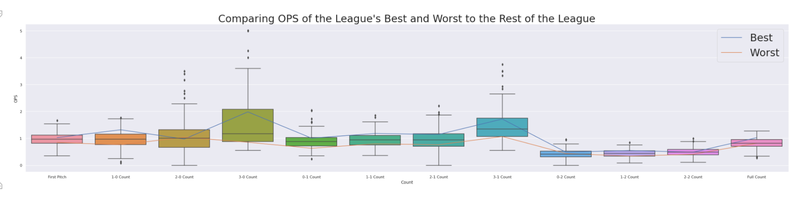
OPS of the League’s Best and Worst Compared to the rest of the League
Boxplot: OPS of all MLB Hitters
Blue Line: Average OPS of the Best Hitters (Shown Earlier)
Orange Line: Average OPS of the Worst Hitters (Shown Earlier)
Notes:
When looking at the OPS of the hitters on different counts, we wanted to compare them together to see if the league’s best were just dominating early and advantageous counts, or could do it on all counts. Looking at this graph, with the exception of 2-0, the star hitters were consistently at the top end of the box plot, while the worse hitters stayed near the bottom. Even though the 2 strike counts are closer, there is still a difference between the two different sets of players

Slide 9
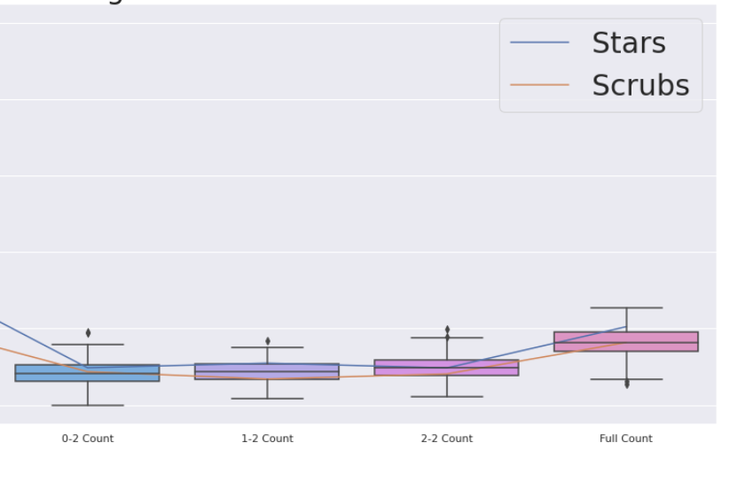
Further Comparison of the League’s Best and Worst
Notes:
Part of the last graph, showing the differences in the 2 strike counts

Slide 10
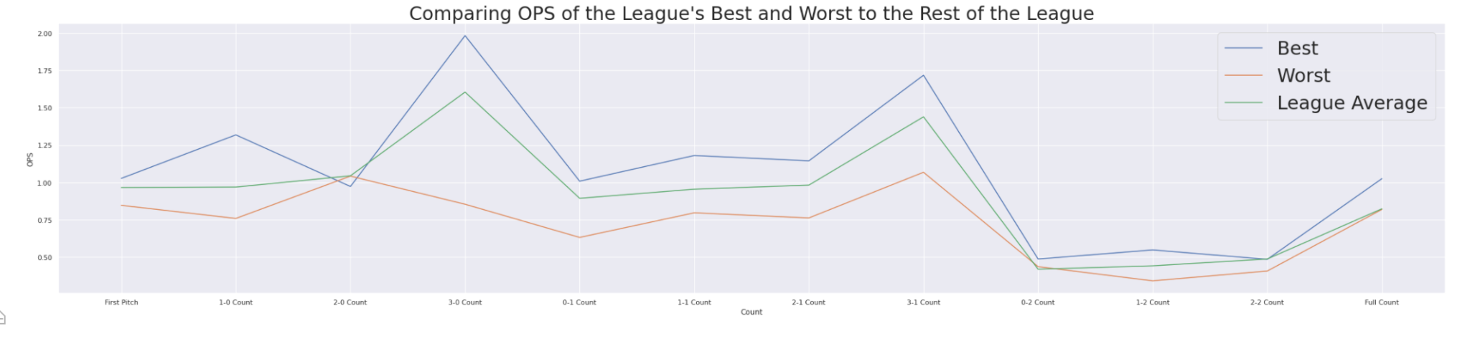
Conclusion
In conclusion, we determined that even though all players do better on more favorable counts in comparison to the less favorable ones, there are still clear differences between the best and worst players on all counts. It’s interesting how the jumps between counts are pretty consistent between the entire league.

Slide 11
Questions?
Notes:
While we know the overall metrics to analyze the best and worst players in the MLB, we wanted to offer the question, are the best players consistently the best across all pitch counts, or do they simply make the most of the easier opportunities? And is this the same for the worst players? In our presentation, we go through this question and explain our data collection as well as some of the niche baseball statistics. In our analysis portion, we discuss how both the best and worst players in the league have similar ups and downs across favorable and unfavorable pitch counts. However, when we examined their statistics relative to the league, we found that the consensus best players are consistently better than the consensus worst players.

